Slide 1
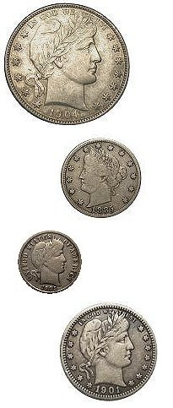
Introduction to Barber Coinage
Speaker Name
Event / Event Location / Date

Slide 2
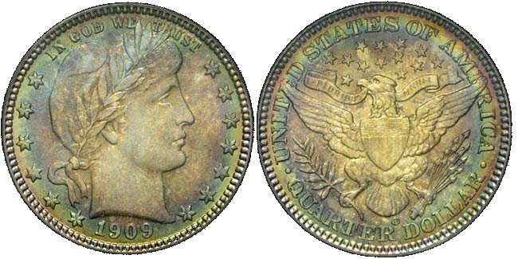
Barber Coin Collectors’ Society
Founded in 1989
250+ members who enjoy Barber coinage
Barber coinage experts
Research, education and social interactions
Dues are $15 per year.
~ 20 Regional Meeting events per year
2015 and 2016 Officers
John Frost, President
Carl Feldman, Vice President
Dave Earp, Secretary/Treasurer

Slide 3
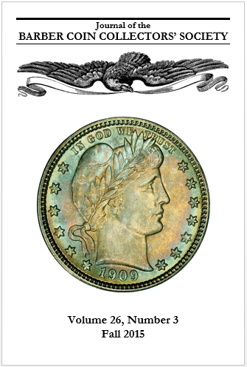
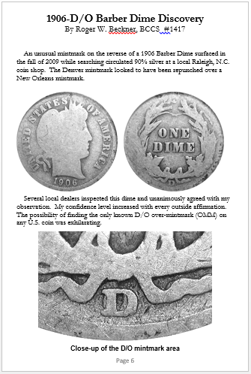
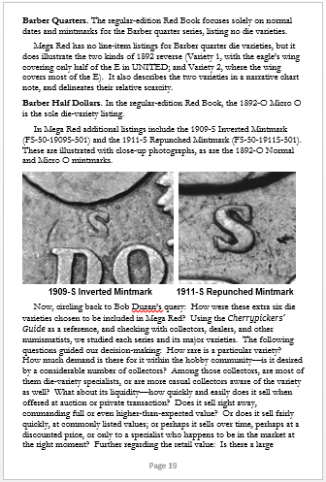
Journal of the Barber Coin Collectors’ Society
Published 4 times per year
John Frost, Editor 2015-
Detailed Research, Collecting Notes, Surveys, Club Member Stories

Slide 4
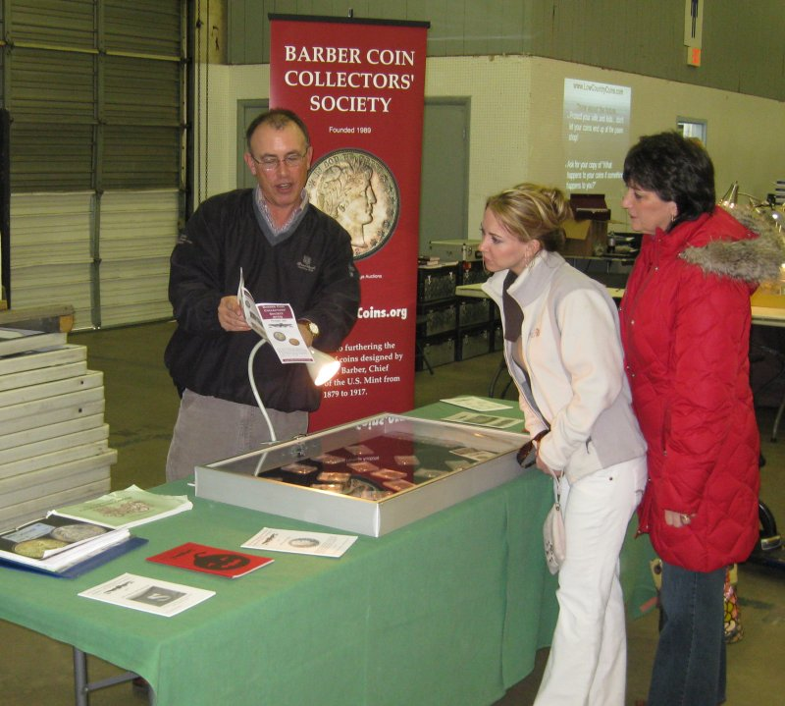
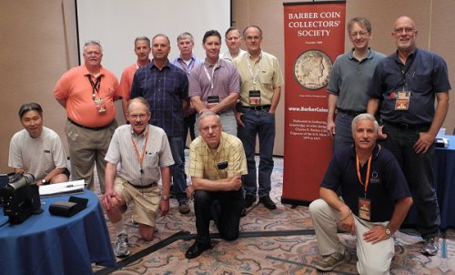
Regional Meetings
Social opportunities
~20 events annually nationwide
FUN, ANA, Baltimore, Long Beach, Manchester NH, Bay State, Rochester, Charlotte, Knoxville, Houston

Slide 5
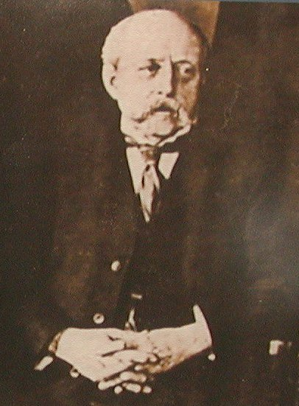
Charles Edward Barber
1840: Born in London England
Designer, engraver and die maker
1852: Moved to Philadelphia with father, William Barber
1869-1879: Assistant Engraver
1880-1917: Chief Engraver
Patterns, medals, regular issue silver and nickel coinage, commemoratives, and Hawaii, Dominican, and Cuban issues

Slide 6
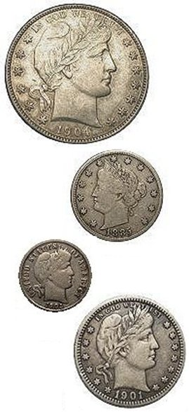
Barber Coin Collectors’ Society
Collectors of coins designed by Charles E. Barber
Chief Engraver of the U.S. Mint 1880-1917
4 series
Liberty Head (Barber) Dimes
Barber Quarters
Barber Halves
Liberty Nickels

Slide 7
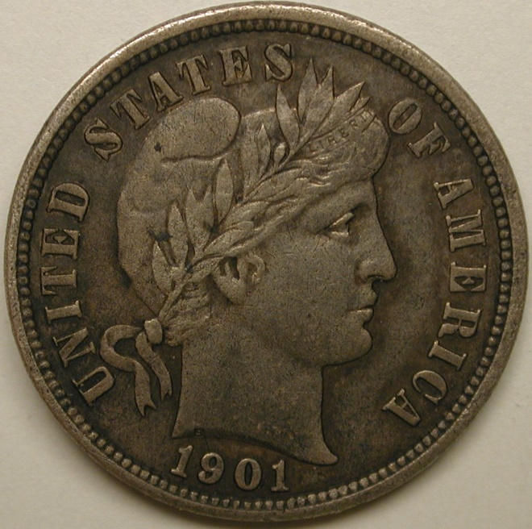
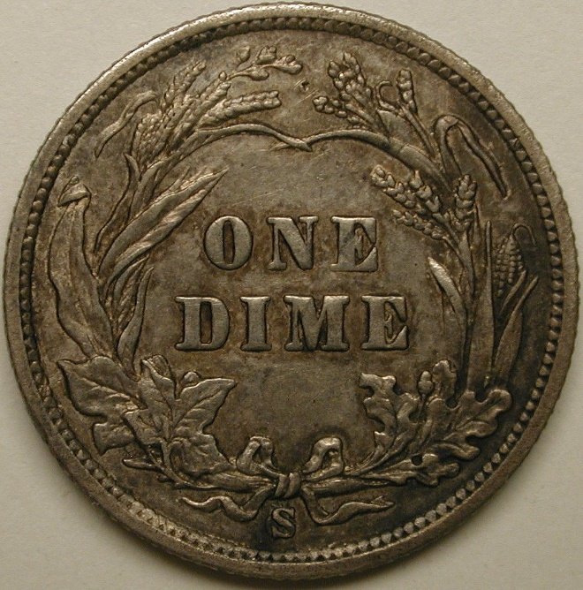
Barber Dimes 1892-1916
74 regular issues (dates and mints)
All but a few dates are readily available in lower grades
Most 20th-century dates readily available in all grades
Coins stand up well to wear and look decent down to VG
Key date: 1895-O (mintage 440,000)
Semi-keys: 1895, 1892-S, 1901-S, 1903-S, 1904-S, others
Complete sets very achievable

Slide 8
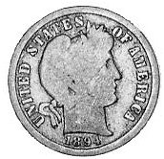
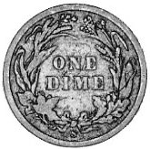
1894-S Barber Dime One of the top classic U.S. Rarities!
Only 24 coins struck
Mysterious origin
9 confirmed specimens known
2 circulated (both ~ Good)
15 unaccounted for, and presumed circulated and lost
Finest known (“Proof” 66) sold for $1,997,500 million in 2016!

Slide 9
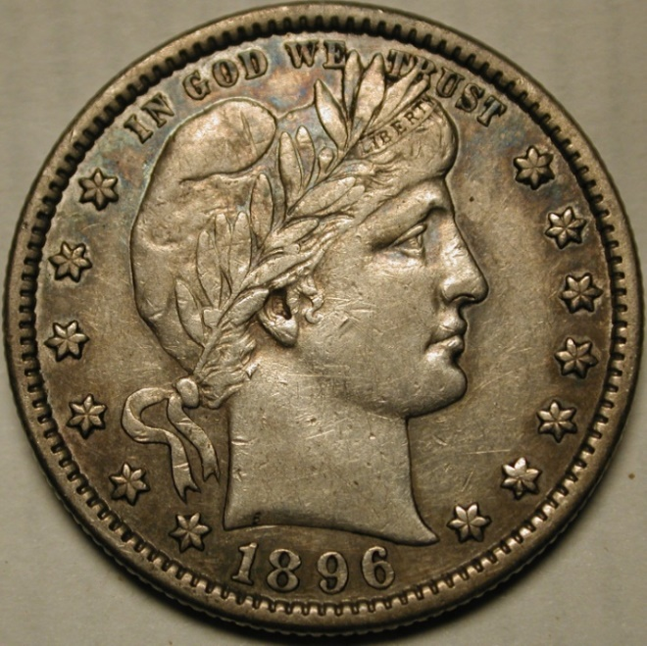
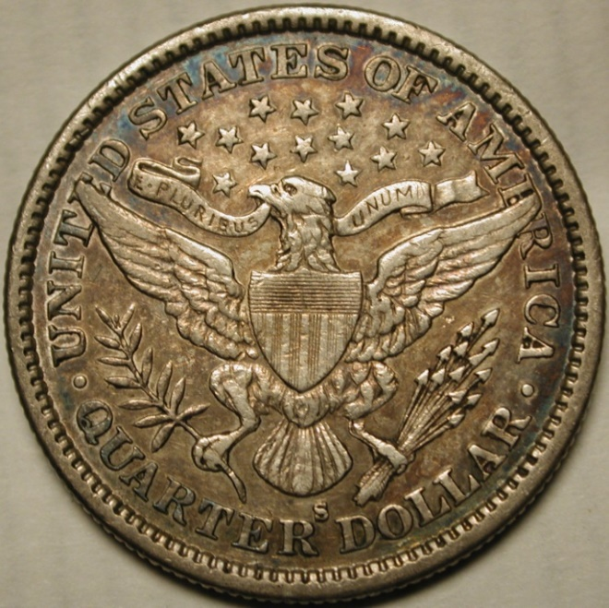
Barber Quarters 1892-1916
Most often available AG-G
Although less so now! (silver melt)
Mid-grade (F-XF) sets very hard to complete
Many semi-keys nearly impossible to find in better circulated grades
Uncs often available for a price (except for a few dates)
Original coins getting impossible to find

Slide 10
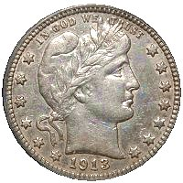
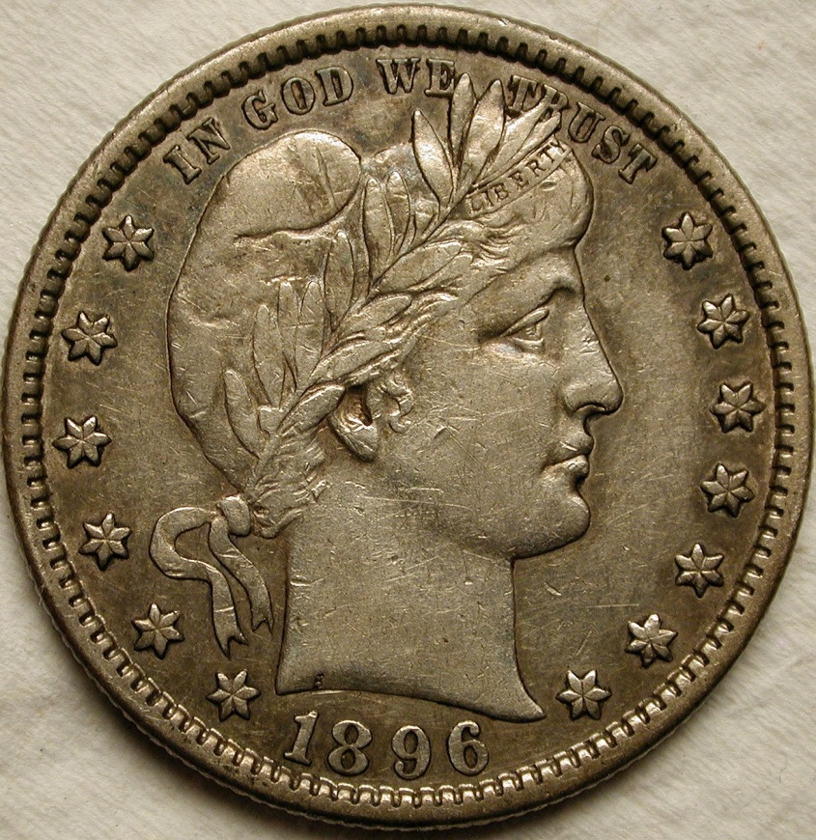
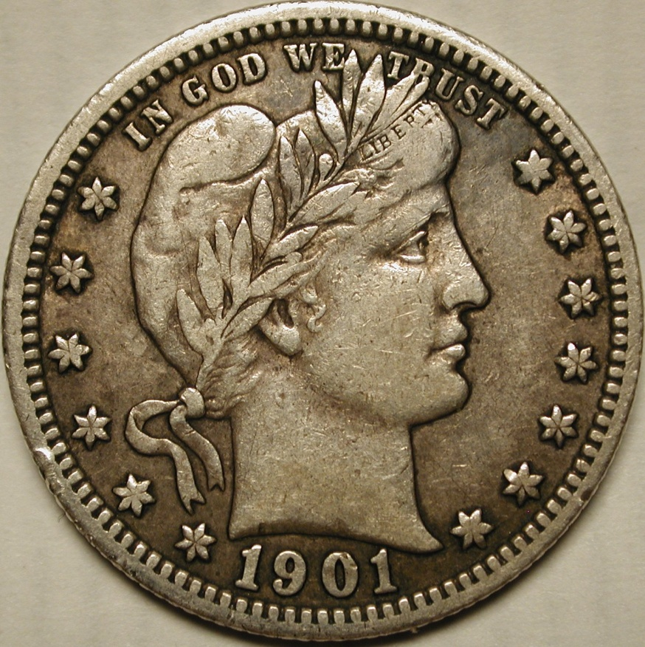
The “Big 3” – Can be budget busters
1896-S (188,039)
Roughly as tough as 1895-O dime
Available AG-VG, scarce finer
1901-S (72,664)
King of 20th Century regular silver
Available Fair-VG, rare Fine-Unc
1913-S (40,000)
Lowest 20th Century Mintage
Available Ugly Fair to VG, and UNC
Rare Fine-VF, extremely rare XF-AU
Many people now build sets minus the 1901-S (or all 3)

Slide 11
Other difficult dates – Can be almost impossible to find nice
1897-O and 1897-S
Philippine hoard dates: 1898-S, 1899-S, 1900-S
1901-O
almost never encountered above VG
1905-O
1908-S
1909-O
rare in higher grades
1914-S
This date has the same mintage of 1916-D dime, at a fraction of the cost

Slide 12
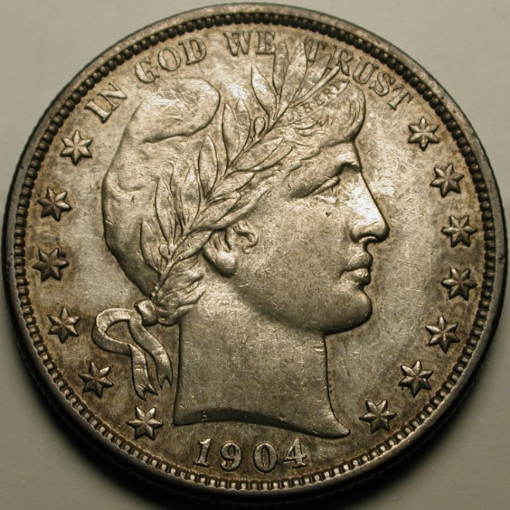
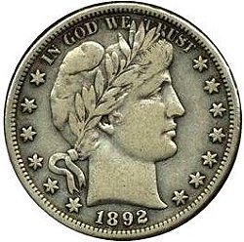
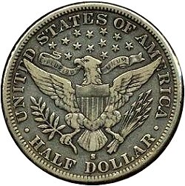
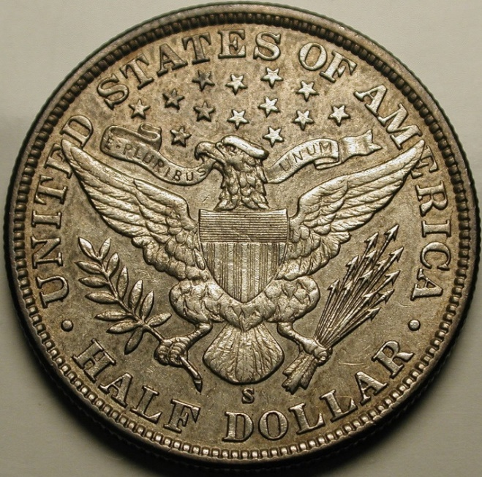
Barber Halves 1892-1915
No show stoppers!
Easiest set to complete in G-VG
Low grade keys:
1892-O and 1892-S
1897-O and 1897-S are next
High grade keys are different!
1904-S by a good margin
1901-S and 1896-O are next
1904-S is the rarest regular issue Barber coin in Mint State
Many slabbed Uncs aren’t

Slide 13
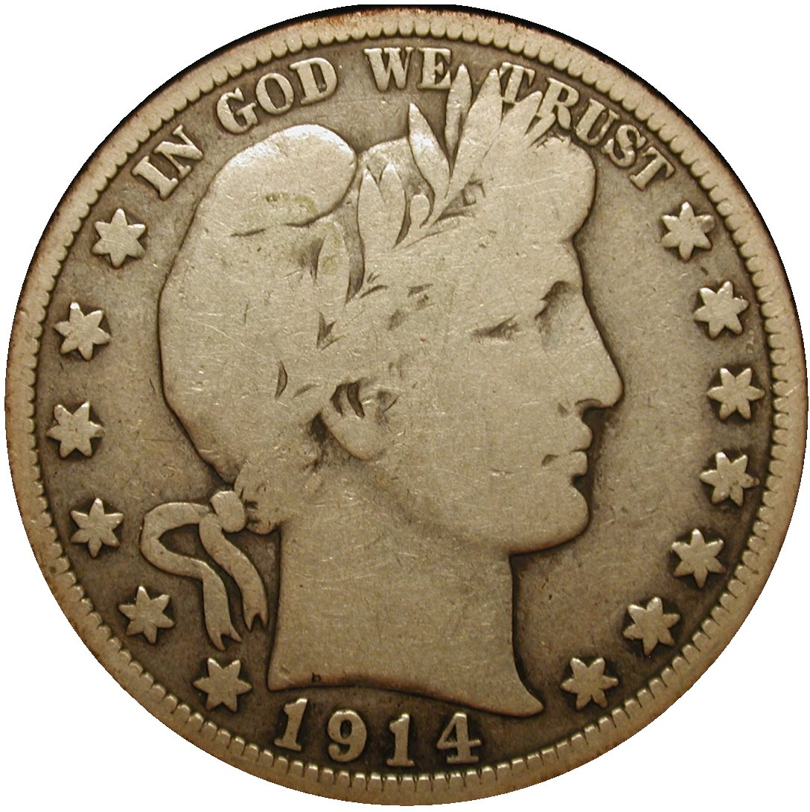
Low-mintage P dates!
1910 – 418,000
1913 – 188,000
1915 – 138,000
1914 – 124,430
1910 mintage less than 1909-S VDB, but VG = $35!
Touted as rare, but hoarded in G-VG
All of these are ALWAYS available in lower grades
In high grades, they are all tough

Slide 14
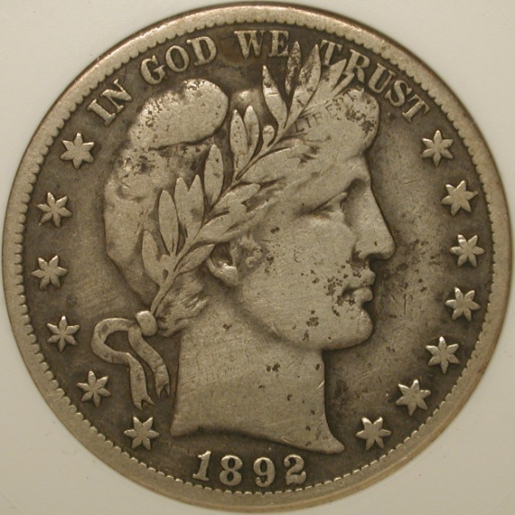
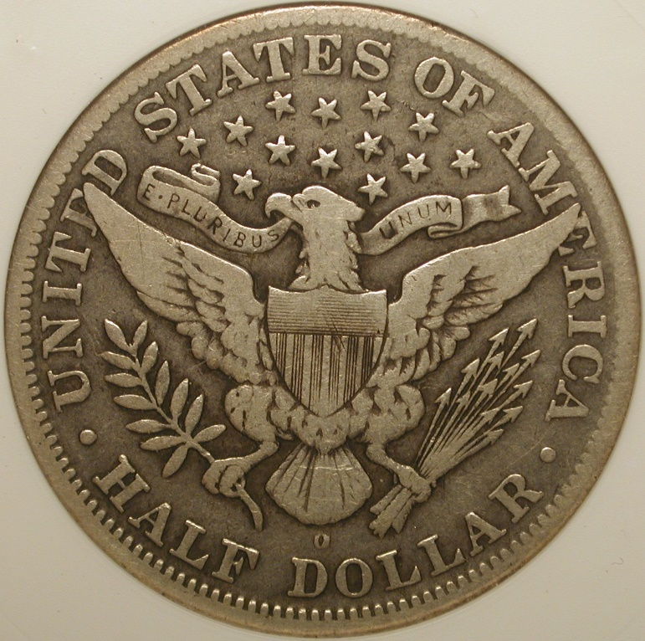
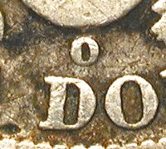
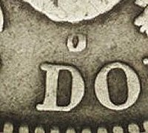
1892-O Micro O
Reverse die with Mintmark intended for the quarter
Error apparently realized quickly and die replaced
Variety discovered 1893
Only 40-55 known
Most often seen AG-G, or Unc

Slide 15
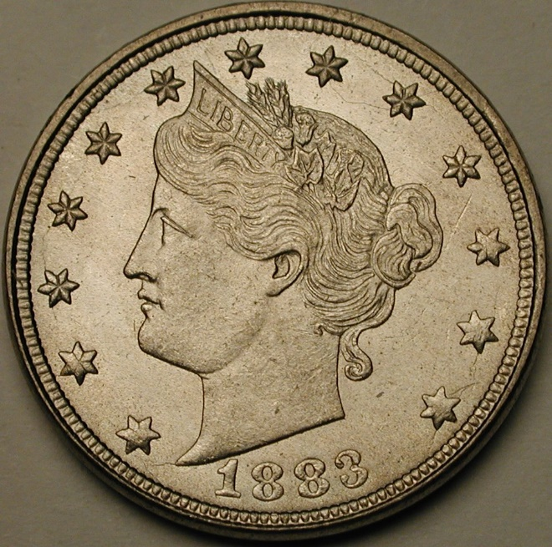
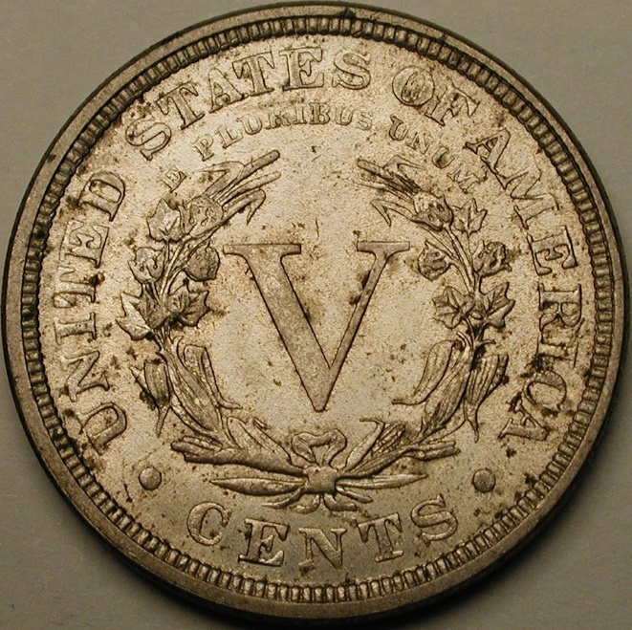
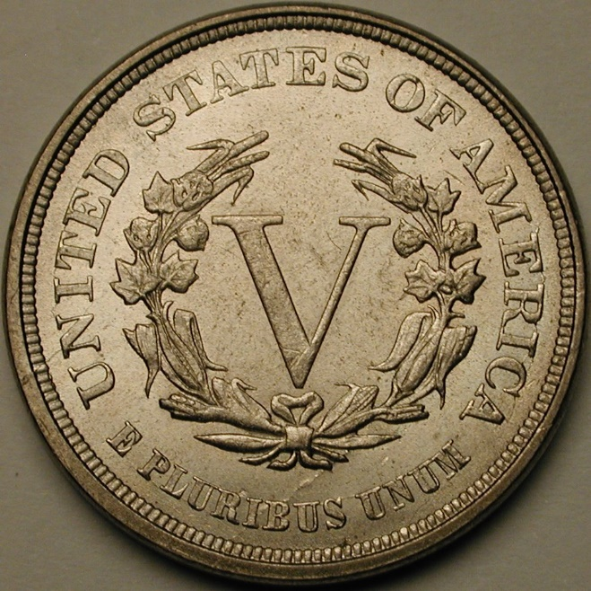
Liberty Nickels 1883-1912
Charles Barber’s first coin
Entirely made in Philadelphia except final year 1912 (D,S)
33 dates and mints
First year has the No Cents and With Cents varieties
A couple of keys, and few tough dates otherwise
Ended with unauthorized clandestine issue in 1913

Slide 16
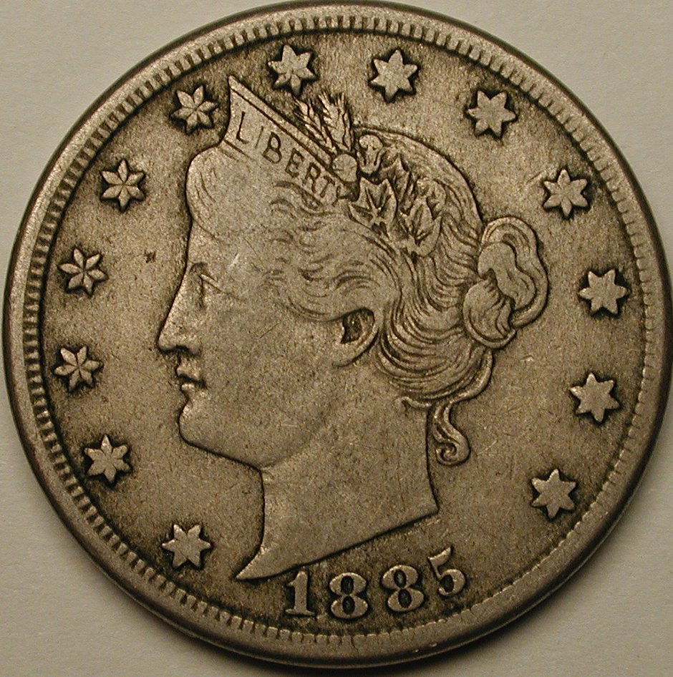
Collecting the series
1885 is the undisputed key
Usually in ugly Fair-AG
Proofs more common than VF-Unc
1886 and 1912-S are next
Mainly exist in low grades
Most dates common all grades
Completing series is very doable
More people are collecting the Proof series (31 coins)
Many collect by type: 1883 without and with CENTS

Slide 17
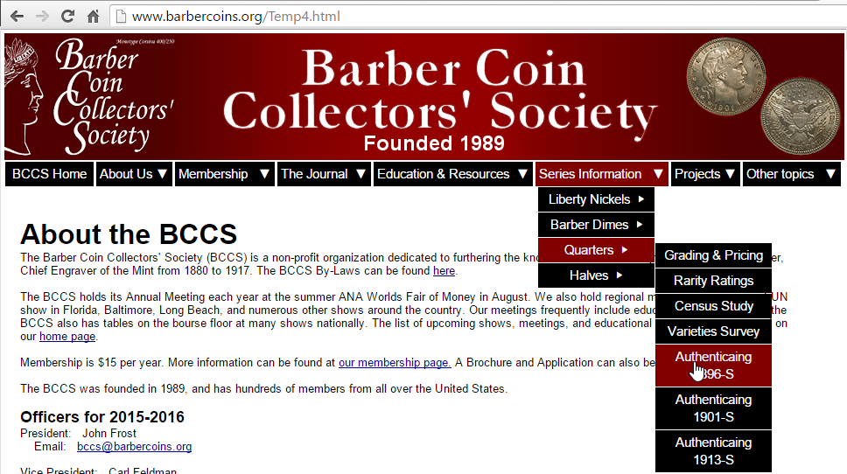
www.BarberCoins.org
Information about BCCS
Brochure and member application
Sample Journal
List of upcoming meetings
Information on all 4 series
Grading, links to values
Authentication of “Big 3” quarters
Rarity Ratings by date and grade
Census/Survey Reports
Contemporary Counterfeits page
Member Gallery (coin images)
Barber Patterns and Medals
Links to online references

Slide 18
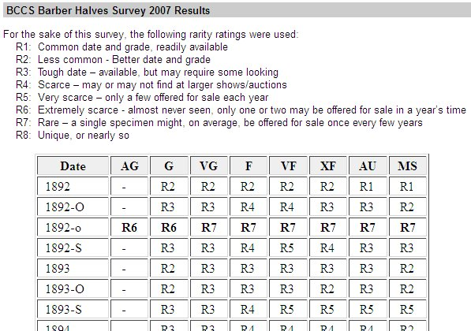
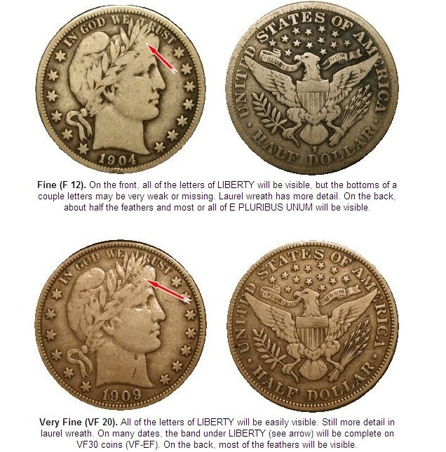
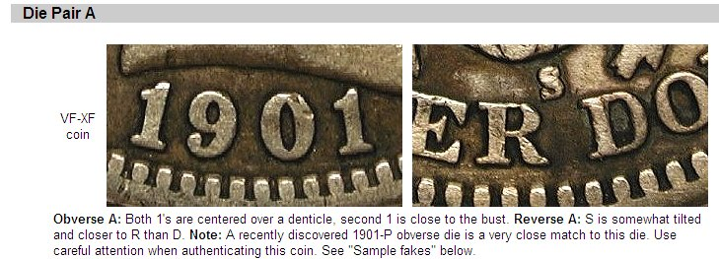
Website – Series information

Slide 19
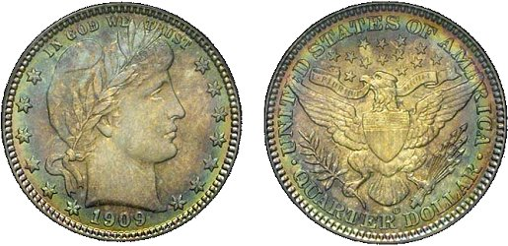
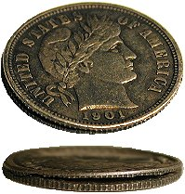
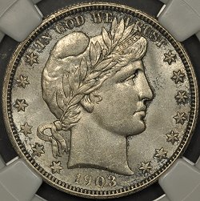
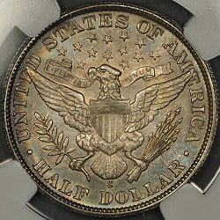
Website – Members Gallery

Slide 20
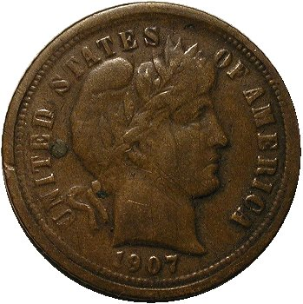
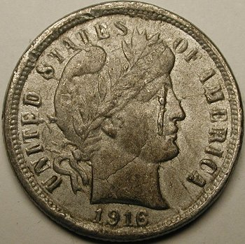
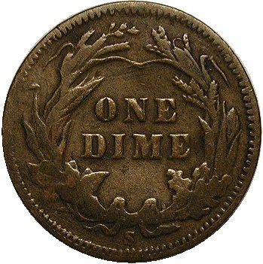
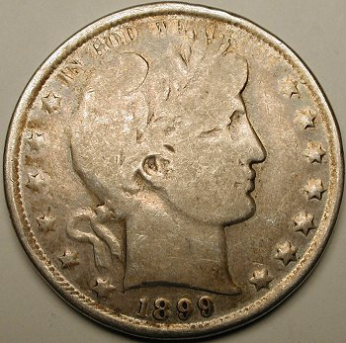
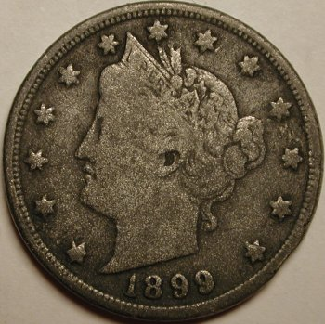
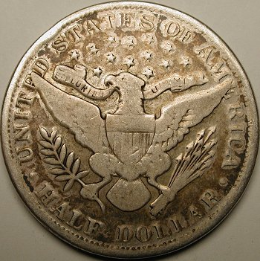
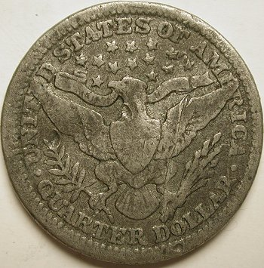
Website – Contemporary counterfeits

Slide 21
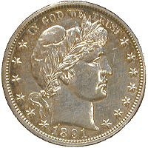
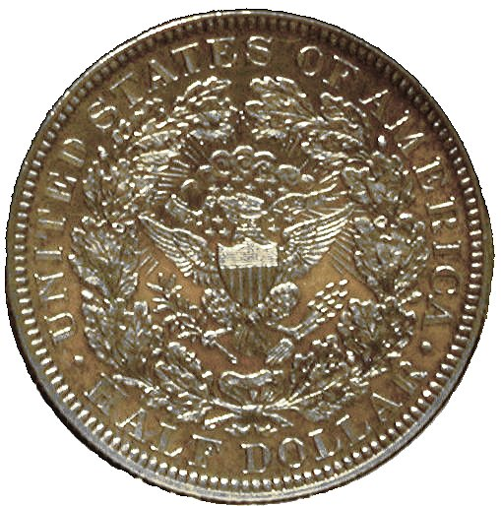
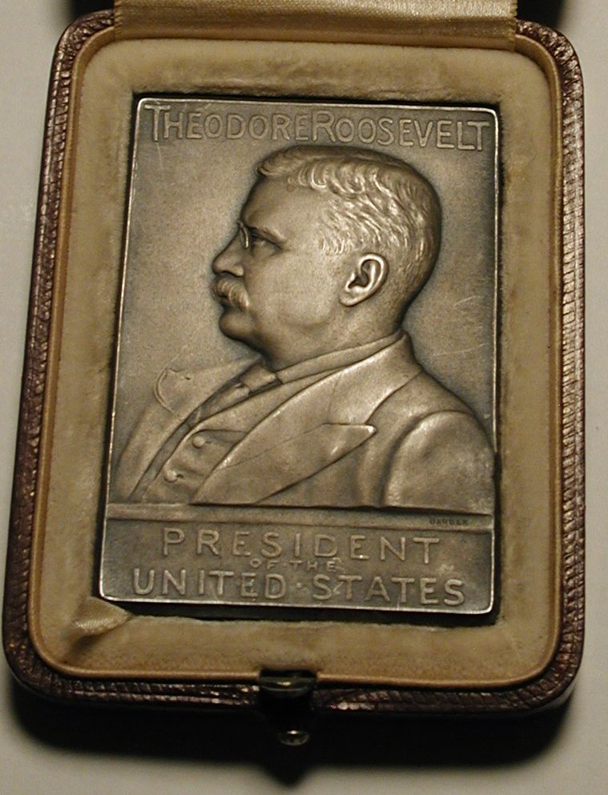
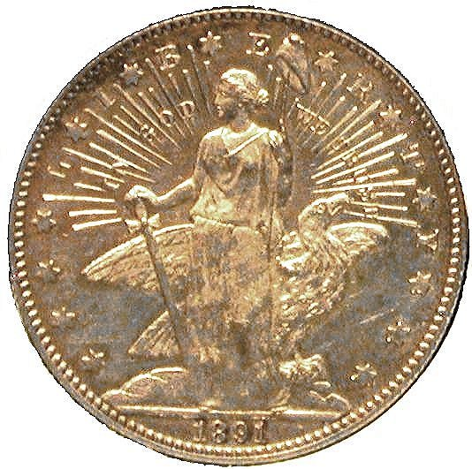
Website – Patterns and Medals

Slide 22
Website – Online references
DLRC Press – DavidLawrence.com
Complete Guide to Barber Dimes
Complete Guide to Barber Quarters, 2nd Edition
Complete Guide to Barber Halves
Complete Guide to Shield and Liberty Nickels
Links to these books from our website

Slide 23
Questions?

