Slide 1
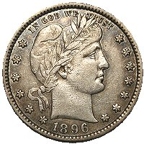
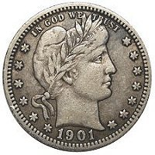
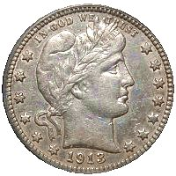
Authenticating the
“Big 3” Barber Quarters
Notes:
This presentation shows you how to authenticate the three key dates in the Barber quarter series. All three of the keys are subject to counterfeiting and alteration, and it is important to know how to tell the genuine from the fakes.

Slide 2
The problem…
The “Big 3”
  1896-S
  1901-S
  1913-S
The three key dates in the series
  By far the most expensive
  Impressive price gains in the past decade
  All subject to fakery
    Mostly added mintmarks
Notes:
The “Big 3” Barber quarters are the rarest, and most expensive coins in the series, and are subject to forgery. They are:
1896-S
1901-S
1913-S
Making the problem worse, large price gains in the past decade have increased pressure on counterfeiting or altering genuine coins to appear to be the 3 keys.
All three of the coins are subject to fakery, and most of the fakes seen are added mintmarks.

Slide 3
The good news
Only two die pairs were used for each date
  The mint marks were hand-punched into the dies
  “1896” and “1901” were hand punched
Thus, these are all in specific positions
Other characteristics unique to each date
  Die cracks, clash marks, edge reeding
Relatively simple to authenticate these coins
  If you know what to look for
Notes:
While authentication is critical, there is some good news.
First of all, with such low mintages, only two pairs of dies were used for each of the three dates, and the mintmarks were hand-punched into the dies, resulting in two distinct and different mintmark positions for each date. Also, the dates for 1896 and 1901 were also hand-punched into the dies, resulting in different date positions for the S-mint coins from the P- and O-mint counterparts.
Thus, if the coin in question does not exactly match the date and mintmark positions of either of the genuine die pairs, it should be obvious
In addition to date and mintmark position, other characteristics exist for each of the three issues, which can aid in authentication, such as die cracks, clash marks, and the reeding along the edge of the coin
As a result, even though the Big 3 are expensive coins and need to authenticate is essential, it is relatively straightforward to do, as long as you know what to look for.

Slide 4
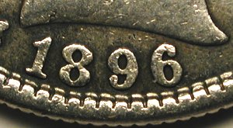
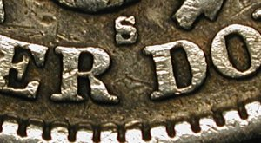
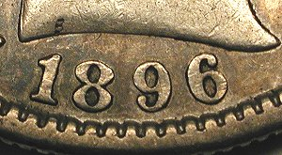
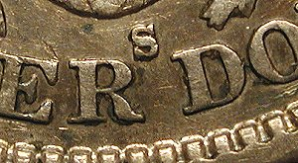
1896-S
The two known die pairs
Two date and mintmark positions
Also note style of mintmark (more boxy than 1898+)
#1
#2
Notes:
First of all, let’s examine the 1896-S.
There are exactly two valid date positions, and two valid mintmark positions. The two genuine die pairs are shown here.
For the date positions, note the position of the “1” compared to the denticles and the initial “B” in the truncation of the bust – Obverse 1 has the “1” centered over a denticle, whereas Obverse 2 has the date slightly to the right of that of Obverse 1.
Reverse 1 has the mintmark higher positions than that of Reverse 2. Also, note the style of the “S” – it is slightly boxy in shape, like all Barber Quarter S-mint coins from 1892-1897. In 1898, the S was changed to a more open and curved shape, shown to the right.
Many of the “Added S” coins have the wrong style mintmark, which can make identification even easier.

Slide 5
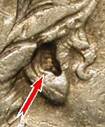
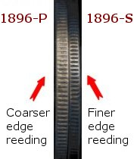
1896-S
Other die markers
Die clash marks in ear
  Present in majority (but not all) from both dies
  Not seen to date in 1896-P or 1896-O
Edge reeding is finer than either P or O mint
page 5
Notes:
Other key characteristics of genuine 1896-S quarters can also aid in authentication.
The most obvious to see (especially in coins in 2x2 holders) is the presence of clash marks in Liberty’s ear. Early in the production runs, both obverse dies clashed with the reverse dies, resulting in horizontal clash marks within the earlobe (they are from the horizontal lines on the shield on the reverse). MOST but not all genuine 1896-S quarters, perhaps more than 75%, have them. Since we haven’t seen any 1896-P or 1896-O coins with similar clash marks, this is a very useful tool to use. If a 1896-S has the clash marks, it is most certainly genuine. However, if a coin does not have the clash marks, it doesn’t mean it’s fake. Not all 1896-S coins have them.
Also, a slam dunk method includes looking at the edge reeding. The three mints (P, O, S) used different retaining collars, with different fineness of edge reeding. The S-mint collar had a finer edge reeding than either the P or O coins. So, if you place an 1896-P and an 1896-S side-by-side, and the S mint coin has a finer reeding (more reeds around the coin), it is genuine. If it has the same edge reed count as the P-mint coin, you have a forgery.
Edge reeding is usually present on coins of grades VG and above.

Slide 6
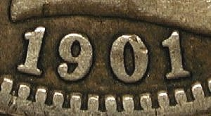
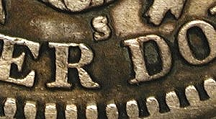
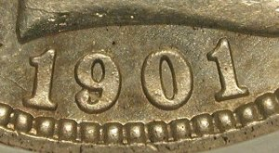
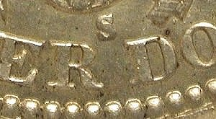
1901-S
The two known die pairs
Two date and mintmark positions
Obverse A is easier to confirm
A
B
Notes:
The 1901-S is the King of regular issue Barber coinage. It was also made with two pairs of dies, with different date and mintmark positions.
Obverse A has the first “1” in the date centered directly over a denticle, and the top of the second “1” nearly touches the base of the bust (and it is also centered over a denticle). Whereas Obverse B has ones centered over the left side of a denticle, and the second one is not close to the bust – it is centered between the bust and the denticles.
The two mintmarks positions are also in specific orientation. Reverse A has the S somewhat tilted and slightly closer to the R than the D. Reverse B finds the mintmark more upright, and centered between R and D.

Slide 7
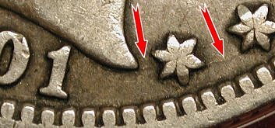
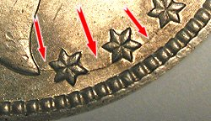
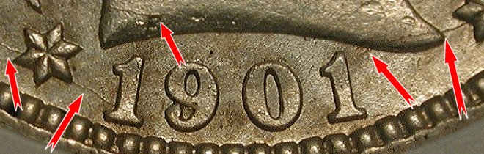
1901-S
Other die markers
Die cracks developed on both obverse dies
Not required, but can
confirm authenticity
Notes:
Other die markers can help confirm a 1901-S quarter is genuine. Both obverse dies cracked during the production run. If a purported 1901-S has these die cracks, then one can feel safe the coin is genuine.
Shown here to the upper left is Obverse 1 (“1” digits centered over denticles, second “1” is nearly touching bust). The lower two pictures are Obverse 2. The die cracks in the starts to the right of the date and tip of the bust are protected and will be seen even on lower grade coins.
Again, most genuine 1901-S coins don’t have these die cracks, but if yours does, it’s going to be real.

Slide 8
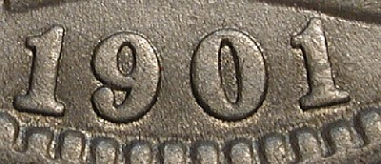
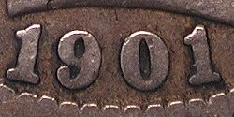
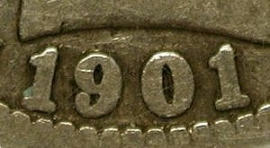
1901-S
Other advice
Look at the edge of the coin for a seam (mule)
Some 1901-P obverse dies are close matches
  Beware subtle differences in date position
1901-P
A
B
1901-S
Notes:
With a high mintage, some of the 1901-P dies (also with hand-punched dates) will have date positions similar, but not identical to the 1901-S dies. Shown here are two 1901-P dates that are similar to both 1901-S dates, but not exactly the same.
Be careful of subtle differences. The more genuine 1901-S coins you see, the easier it is to notice the slight differences.

Slide 9
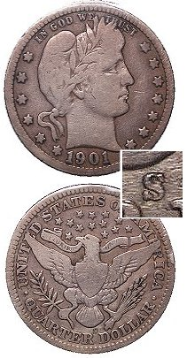
1901-S
Two examples
Added Mintmark
  VG coin, XF mintmark
  Wrong size and position
  Mintmark should match the coin!
Notes:
Here are two different examples of fake 1901-S quarters.
The first one is a typical Added S coin. The mintmark is not only in the wrong position, it is the wrong size and style. In addition, the mintmark looks more like what would be expected on an XF coin, not on the VG coin pictured here. The mintmark should match the coin! A VG coin should have a well-worn VG mintmark on it.
**** next example on next slide (combined)

Slide 10
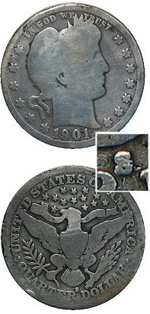
1901-S
Two examples
Added Mintmark
  VG coin, XF mintmark
  Wrong size and position
  Mintmark should match the coin!
Mule of two halves of coins
  No evidence at mintmark
  Seam along reeded edge
  A coin has 3 sides!
Notes:
The next example will fool people who only look for evidence of an added mintmark, and not the rest of the diagnostics.
This was two halves of two different coins, joined together. A 1901-P obverse was paired with a genuine S reverse from a different year. There is no evidence of alteration at the mintmark (because it wasn’t added). However, there was a seam around the reeded edge of the coin. Unfortunately the owner never took the coin out of the 2x2 to examine the edge.
A lesson learned. Remember a coin has 3 sides!

Slide 11
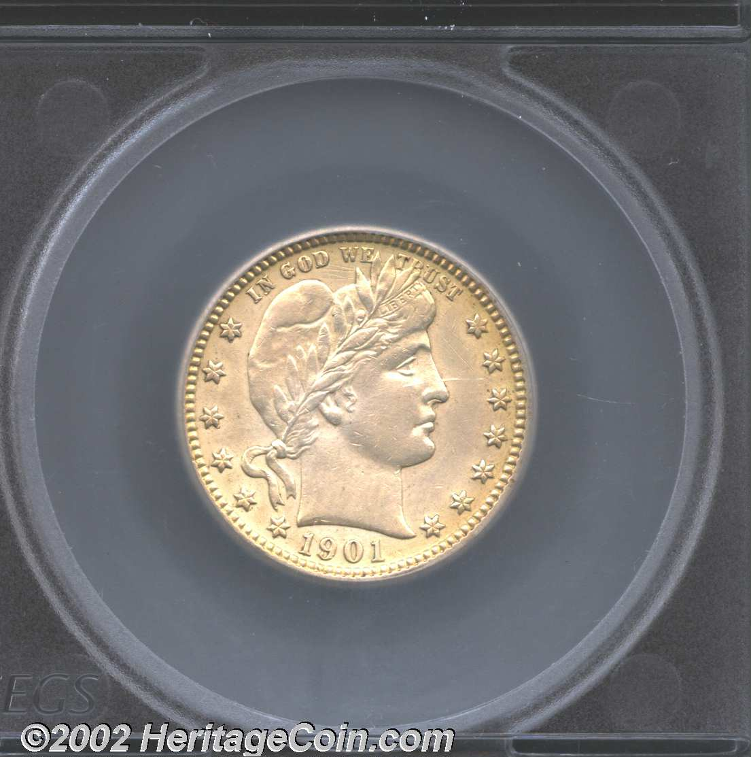
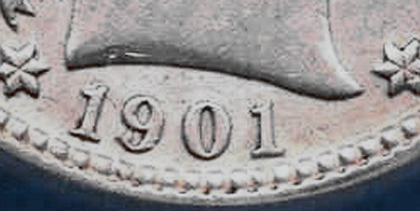
1901-S
Get a certified example, but…
Here is a slabbed 1901-S Quarter…
Too bad this coin is a fake!
The date does not match either of the genuine dies
Not one of the “real” grading services – a lesson to be learned
Notes:
Another thing to consider – buying a certified example. This is great idea, but there can be pitfalls.
Here is a slabbed 1901-S quarter. Unfortunately it is a fake. The date position does not match either of the genuine dies.
The good news: the major grading services (ANACS, PCGS, NGC, ICG) guarantee their work and would make good on their mistake.
The bad news: this coin was in an off-brand slab, from a company that does not have a guarantee.
The lesson: if you want a certified example, choose one of firms that guarantee their work.
This coin was actually sold in a major auction, despite being told by the BCCS that the coin was no good. A month later, they got the coin back when the winner had it examined by somebody who knew. The firm had to eat the loss.

Slide 12
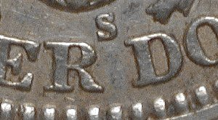
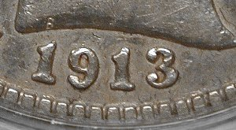
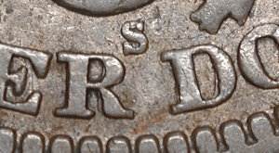
1913-S
The two known die pairs
Date is now hubbed (only one position for all mints)
  Can’t use that as authentication means
A
B
Notes:
The lowest mintage regular issue U.S. silver coin is the 1913-S, with a mintage of just 40,000.
After 1909, the mints hubbed the dates, so that all obverse dies made for all mints had the exact same date position. Therefore, date position cannot be used to differentiate 1913-S from P and O coins.
In addition, the edge reeding count can’t be used, as by this time, all of the mints used similar collars.
However, there are two different mintmark positions to evaluate.
Reverse A has a nicely-centered mintmark between R and D, and Reverse B has a lower mintmark, closer to R than D.

Slide 13
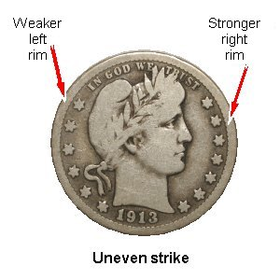
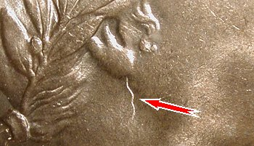
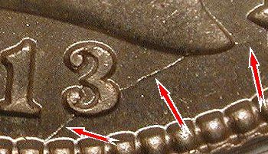
1913-S
Other die markers
Uneven strike is key! Obverse weaker on left side
  1913-P and -D have even strikes
Die cracks may also
support authenticity
Notes:
The single most important characteristic of genuine 1913-S quarters, in addition to mintmark position, is the strike.
The 1913-S quarters received an uneven strike, due to the way the dies were inserted into the press. The left side of the obverse is slightly weaker than the right. The rim is shallower on the left than the right.
This is more easily seen on low-grade coins, but it can also be seen on high-grade and mint state pieces as well.
One of the obverse dies also developed severe die cracks very late in the production run. These are rarely seen, but if a purported 1913-S has these die cracks, it is genuine.

Slide 14
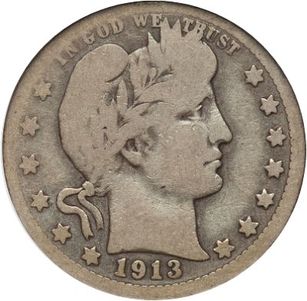
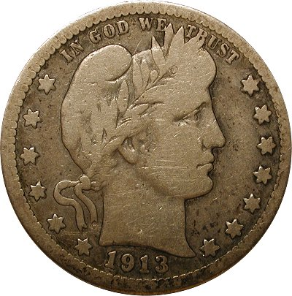
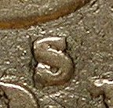
1913-S
You can tell by the obverse!
Genuine!
  Uneven strike, good MM
Fake! Added Mintmark
  Evenly struck, wrong MM
Notes:
Here is an example of a genuine coin (weaker left side) side-by-side an altered coins with an even strike.
Close examination of the mintmark area show evidence of alteration, by affixing an “S” to the back of a 1913 coin.

Slide 15
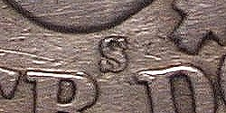
Some last tips
Look at the style and condition of the mintmarks
  Is it the correct style for the date?
  Its condition should match the coin
  A VG coin should not have an XF mintmark!
Be suspicious of coins with a cleaned reverse
Get to know what the genuine coins look like
  You will be able to differentiate the subtleties between the genuine and the close matches
Use only grading services that guarantee their work!
Notes:
To summarize, there are some excellent tips which can make authenticating the Big 3 much easier, and will help you quickly identify the majority of the fakes.
First, look at the mintmark. It must be the right style and size, and it also must match the condition of the coin. A VG coin should not have an XF mintmark.
Be suspicious of coins with a cleaned reverse. Cleaning often is used to hide evidence of alteration, and/or to detract attention from the mintmark.
Look at as many genuine examples as you can, so you can learn what the real thing looks like. That way, when a fake is encountered with a very close (but not exact) match to the genuine, you will notice the subtle differences. It will just “not look quite right”
Finally, buying certified examples is a great idea, but only use the 4 major grading firms that guarantee their work!

Slide 16
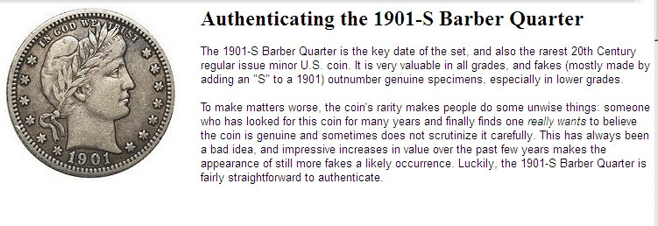
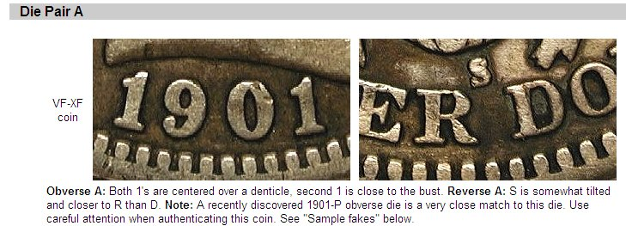
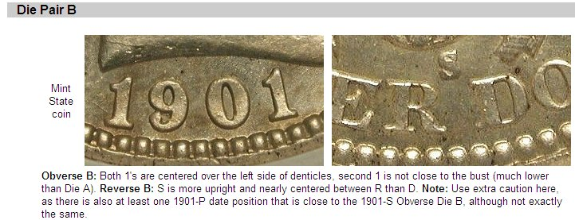
Authenticating the “Big 3”
The BCCS website has detailed pictures of both known die pairs for
  1896-S
  1901-S
  1913-S
www.barbercoins.org
Notes:
The BCCS website has web pages to help you authenticate the Big 3. These pages have high-resolution photos of date and mintmark positions, as well as other key characteristics, as shown in this presentation.
You can find it on www.barbercoins.org under “Series Information” and “Barber Quarters”.

Slide 17
Thank you! Questions?

